Slide 1
Rage ATE

Slide 2
Rage ATE
Purpose: Automate the collection of data for Rage products
Platform: Labview 2018 32bit
ATE Testing type : Nested Loop

Slide 3
Rage ATE
Components
Sequencer: GUI and interface to user. Controls the sequence in which the SW will execute a test from Beginning to End. How a test is sequenced is controlled by the programmer. A test can be constructed by dragging any sequence of Vis into the sequencers execution control. A different sequence name will be used for each test. The sequence can eventually become a check box in a test executive type GUI.

Slide 4
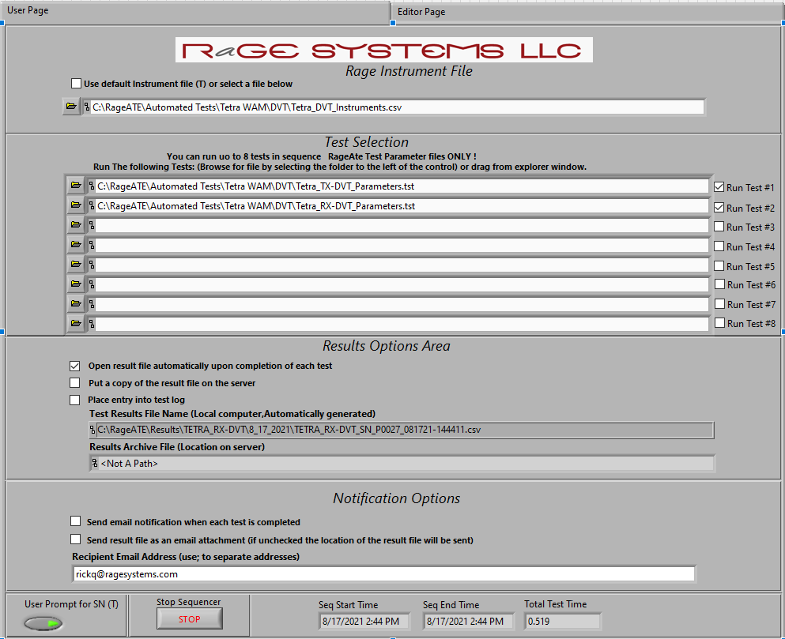
Front page Tab (User Page) of sequencer
Instrument File (.csv)use for all tests in sequence
Test Parameters File (.tst)
Up to 8
If checked, will open each test as it completes
If checked, will copy to server; location varies
If checked, will log test in log file location: C:\RageATE\Test Log_MMYY.csv
If checked, will send an email
If checked, will send an email attachment
Enter email addresses separated by ;

Slide 5
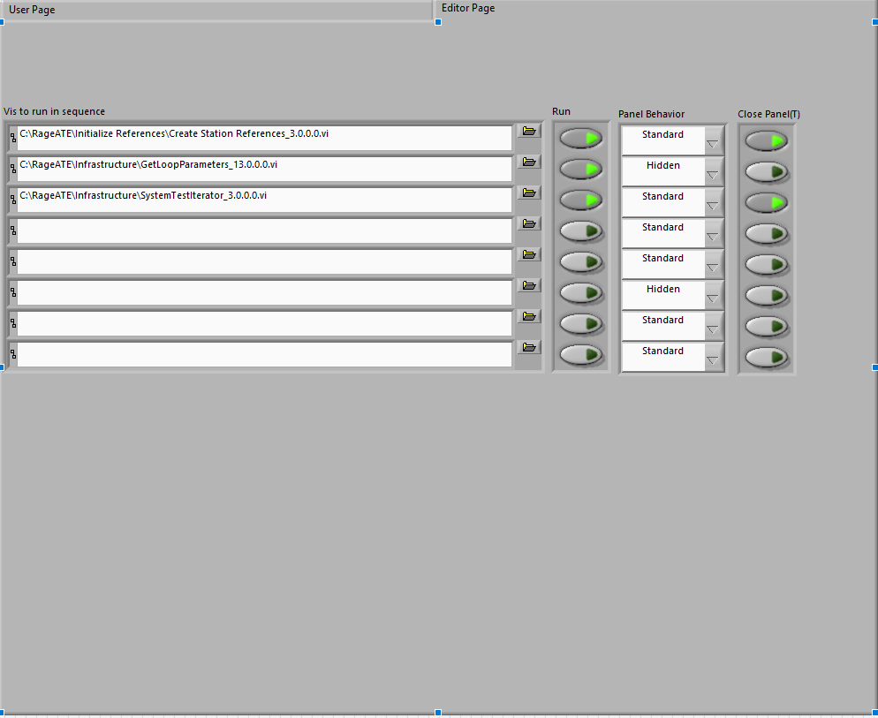
Editor page Tab of sequencer using Tetra DVT as example
.vi to run in sequence
.vi behaviours
Create Station References.vi *required
Scans Instrument list file (from front tab)
Resets to default Instrument conditions
Writes Instrument Globals
Checks List vs presence
GetLoopParameters.vi
Reads Contents of file: …Parameters.tst
Generates Iteration Parameters
Constants (Always the same)
Loop Values (varies by iteration)
Test Parameters.tmp
SystemTestIterator.vi
Runs Setup vi: One Time
Runs Payload vi : Loop until finished
Runs Close vi : One Time

Slide 6
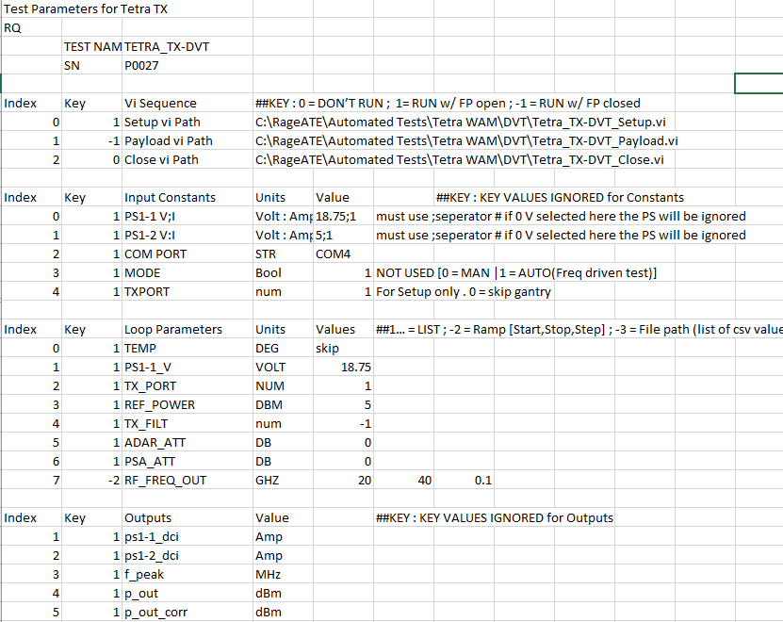
Test parameter File
Serial Number. Overridden by Sequencer.vi “User Prompt for SN”
VI Paths specific to test
.vi behaviours keys
Test Vi’s
Always in this order : Setup, Payload, Close
Constants specific to test
Loops specific to test
Column headers for output data

Slide 7
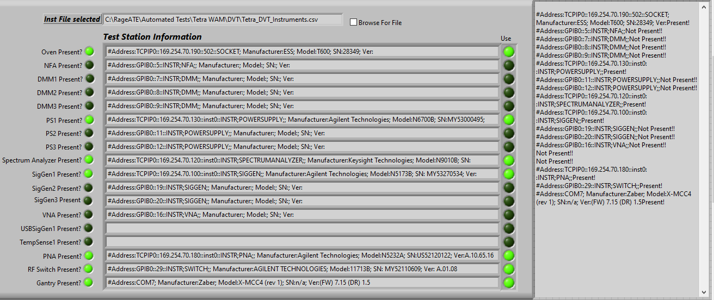
Create Station References.vi
Present?* 1 = True
Inst file (from Sequencer)
Use? 1 = True
*If Instrument Present = 1 and Instrument not used = 0,
Calls to Instrument will be ignored.
Inst Info goes to result file header

Slide 8
Instrument File read by Create Station References
INST NAME
VISA Address
USE*
INST NAME | TYPE | ADDRESS | Use Instrument | Return to Local
OVEN | Temp Plate | TCPIP0::169.254.70.190::502::SOCKET | 1 | 0
NFA | NFA | GPIB0::5::INSTR | 0 | 1
DMM1 | DMM | GPIB0::7::INSTR | 0 | 1
DMM2 | DMM | GPIB0::8::INSTR | 0 | 1
DMM3 | DMM | GPIB0::9::INSTR | 0 | 1
PS1 | PowerSupply | TCPIP0::169.254.70.130::inst0::INSTR | 1 | 0
PS2 | PowerSupply | GPIB0::11::INSTR | 0 | 1
PS3 | PowerSupply | GPIB0::12::INSTR | 0 | 1
SpectrumAnalyzer | SpectrumAnalyzer | TCPIP0::169.254.70.120::inst0::INSTR | 1 | 0
SigGen1 | SigGen | TCPIP0::169.254.70.100::inst0::INSTR | 1 | 0
SigGen2 | SigGen | GPIB0::19::INSTR | 0 | 1
SigGen3 | SigGen | GPIB0::20::INSTR | 0 | 1
VNA | VNA | GPIB0::16::INSTR | 0 | 1
USBSigGen1 | SigGen | 22077 | 0 | 0
TempSense1 | Temp Sensor | USB-TC01 | 0 | 0
PNA | PNA | TCPIP0::169.254.70.180::inst0::INSTR | 1 | 0
RFSwitch | SWITCH | GPIB0::29::INSTR | 1 | 1
Gantry | Gantry | COM7 | 1 | 1
*If Use Instrument = 1 and Instrument not found,
will generate error and give user 1 chance to correct …plug in ,turn on etc..
Else, will quit test

Slide 9
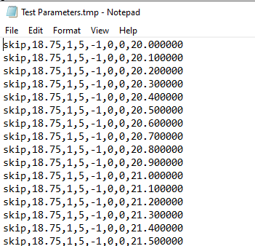
GetLoopParameters.vi (hidden)
-Reads Values from: …TestParameters.tst file
-Writes Array to TestParameters.tmp
File created from values
This file will sweep Freq from 20-40GHz in 100MHz steps
While no other sweeps are done in this case
KEYS : 1… = LIST ; -2 = Ramp [Start, Stop, Step] ; -3 = File path (list of csv values starting at column 0 row 0)
LIST KEY: ENTER NUMBER of VALUES to ITERATE
List Values: Left to Right in columns
Ramp Key(-2): Generate a ramp
Ramp Values: Column 1 = Start, Column 2 = Stop, Column 3 = Step
File Key(-3): Use a csv file list
File Values: Absolute File Path
File Type: 1D array of values in column. Start at top.
40.0

Slide 10
Rage ATE
Components cont.
Iterator: (Typically called by the sequencer), Constructs the loop by taking in user input to drive the testing parameters. A front end .tst file using various control methods to allow user to test over a variety of test parameter types [Start,Stop,Step | List | File]. Essentially, this is the engine that drives the test looping algorithm. The Iterator is the inner loop of the SW and will call the measurement module (payload) each time an execution occurs.

Slide 11
Rage ATE
Components cont.
Setup.VI: A unique to test vi that sets up the instruments ONE time for preparation to be looped. EG a typical operating point for the DUT. A visual or electronic verification can be built into the module for the user to determine whether the setup is ready to continue testing or abort to check for issues.
Measurement.VI : Data collection portion of the SW. Instrument setup and target ranges should be close to ideal. This VI will determine the iteration time of the test. Each iteration is a “one shot” measurement of all the data that will be required for each condition[Temp, Volt, Freq, Power, etc…]

Slide 12
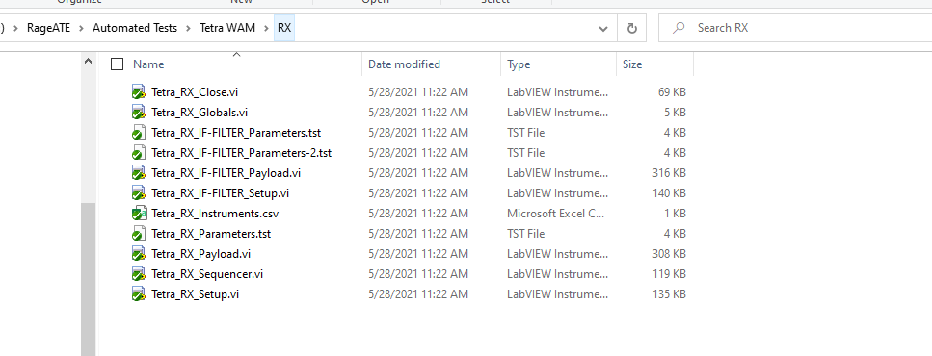
A typical test folder containing vi’s strict to the test.
In this case there are 2 tests in the folder:
1. Tetra_RX_IF-FILTER
2. Tetra_RX
Using Tetra_RX as an example, there are 2 main vi’s that remain strict to the test
Tetra_RX_Setup.vi
Tetra_RX_Payload.vi

Slide 13
Sequencer
User
-Inst File
-Test Parameter File
-Test Data Options
TOP
Edit
-vi to run in sequence:
-CreateStation References
-GetLoopParameters
-System Test Iterator

Slide 14
Tetra RX ATE Test / ADC Capture results directory description
ADC capture directory
Primary data result file
Tetra RX ADC Capture fft data file name description
TEMP_VOLTAGE_PORT_REF POWER_RF POWER_RX FILT_RX GAIN_RF FREQ_CAP TYPE
skip_18p75_1_5_-20_-1_-1_20p001000_sigcapt1.csv

